Slide 1
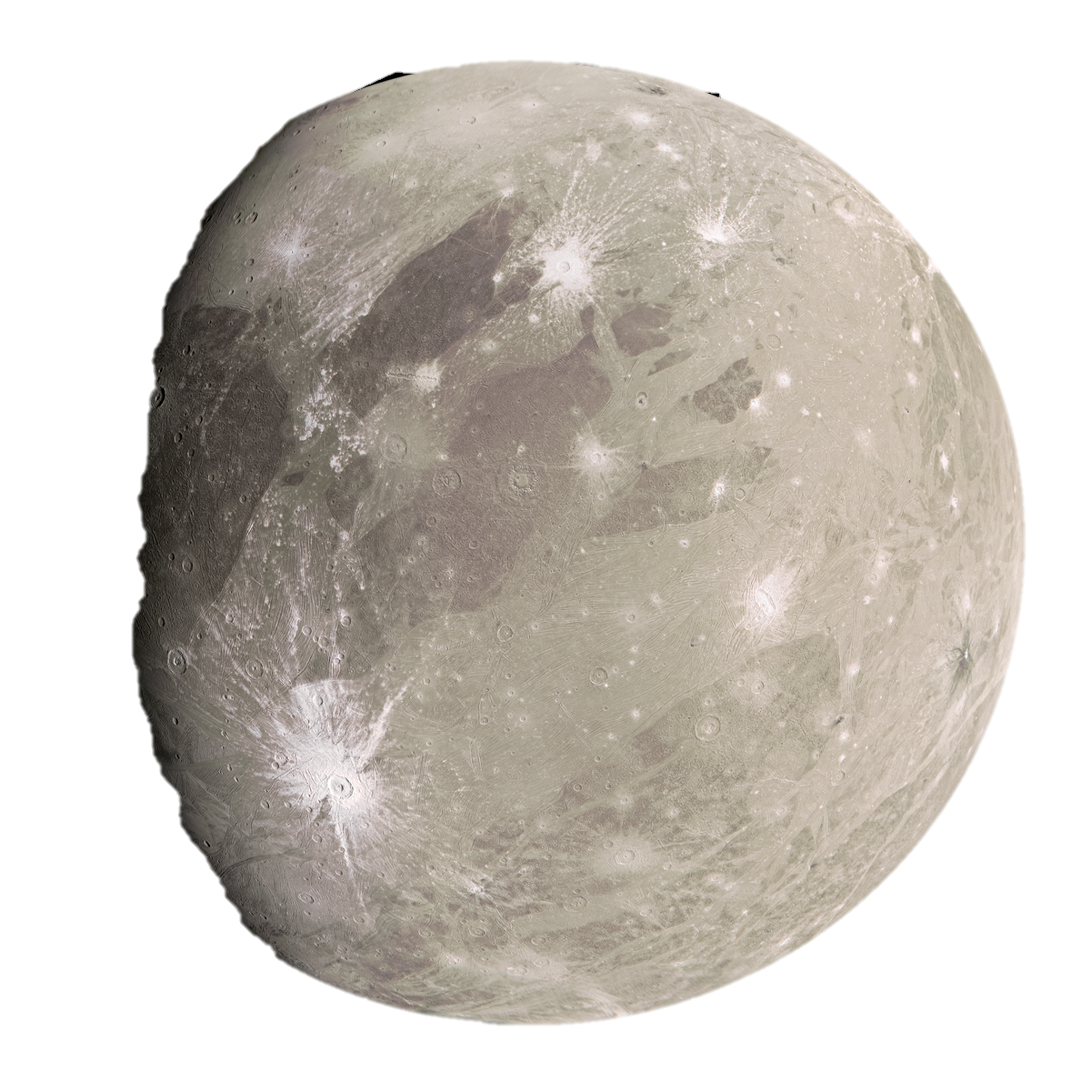
IMAGINE
Investigating Magnetism Around Ganymede in Natural Environments
Notes:
Introducing who we are and the acronym - Hannah

Slide 2
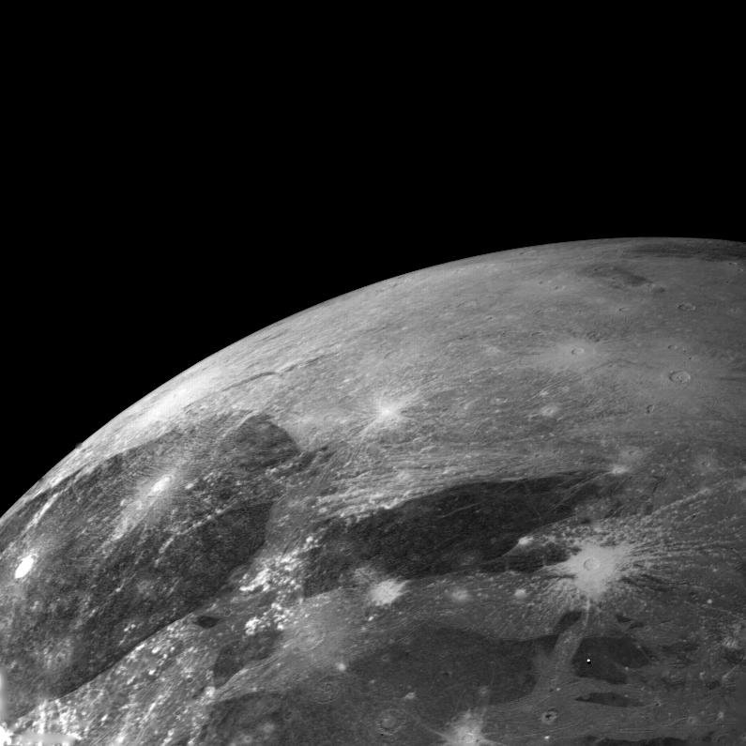
Ganymede-Jupiter interactions
Notes:
Introduction to the topic we are discussing– Issac

Slide 3
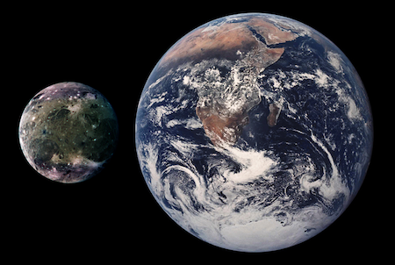
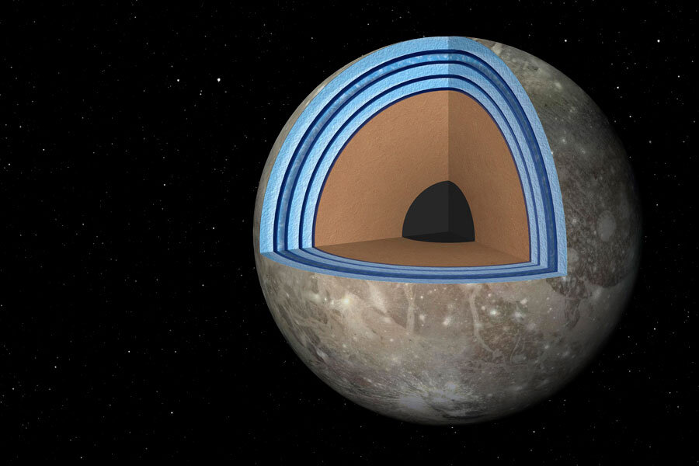
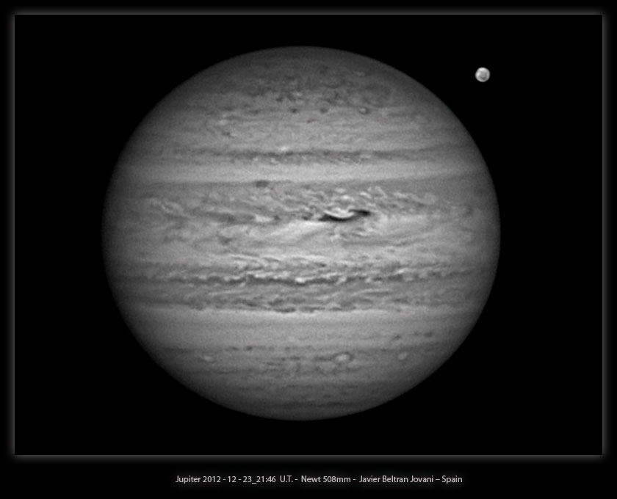
Why Ganymede?
Largest Moon and satellite in the Solar System
Only moon known to have a magnetic field
Orbits Jupiter every 172 hours
Composed equally of silicate rock and ice
Daytime surface temperature of -113ºC

Slide 4
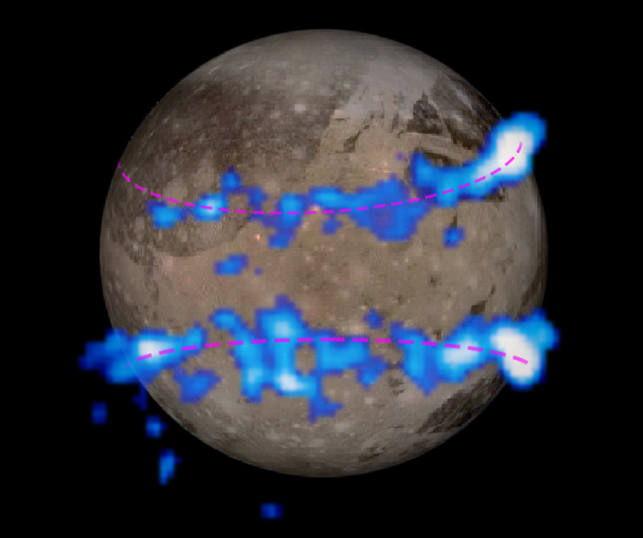
What data is out there?
Many spacecrafts have completed flybys past Ganymede - Galileo, Pioneer 11 & 12, Voyager 1 & 2, New Horizons and Juno
Galileo spacecraft (discovered Ganymede’s magnetic field in 1996) - data from nasa
Pioneer 10 & 11 (physical characteristics)
Voyager 1 & 2 (found Ganymede was bigger than Titan, Mercury and Pluto)
New Horizons observed Ganymede from a far distance and topologically mapped the surface
Juno also observed the surface and explored the craters and polar regions
Hubble space telescope found evidence of a thin oxygen atmosphere on the surface - icy surface.

Slide 5
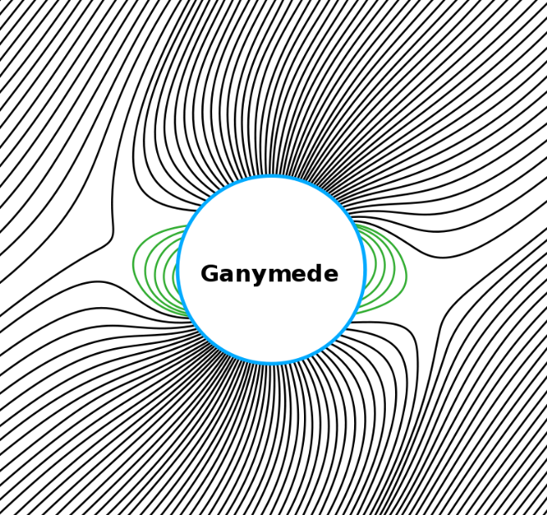
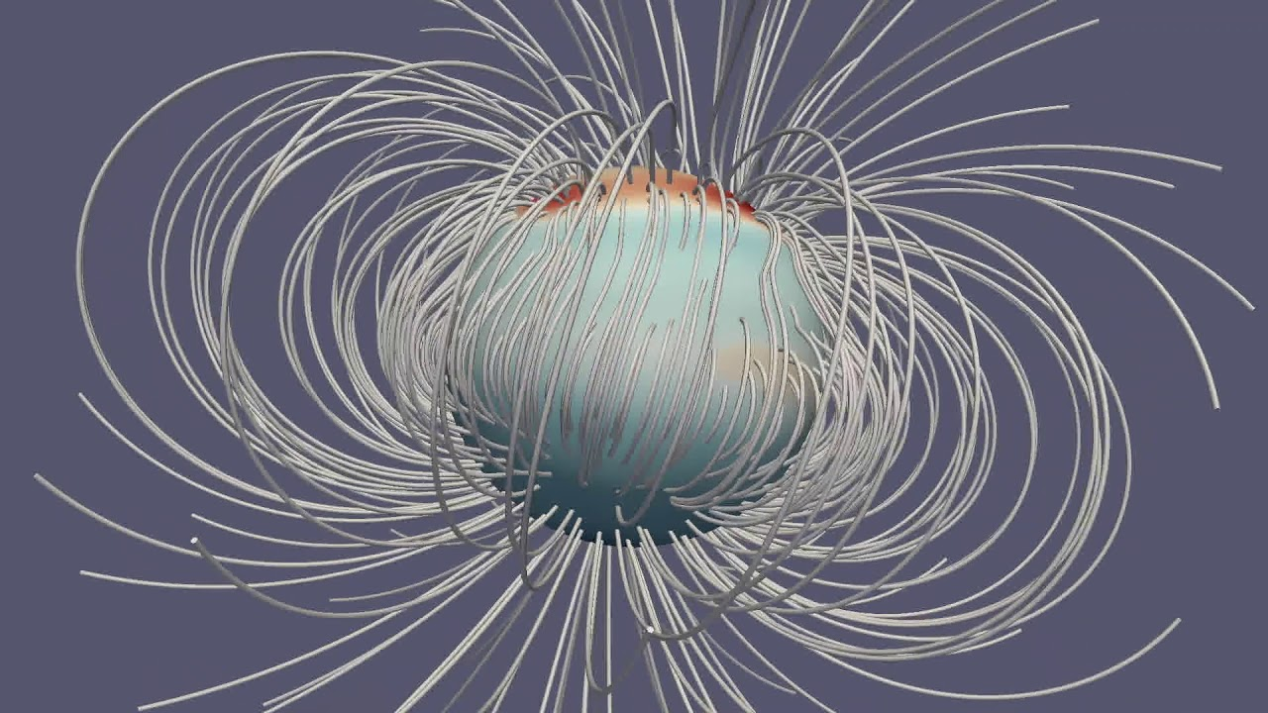
How can we analyse this?
Ganymede's magnetic field
Simulation and approximations
Programs that will be used

Slide 6
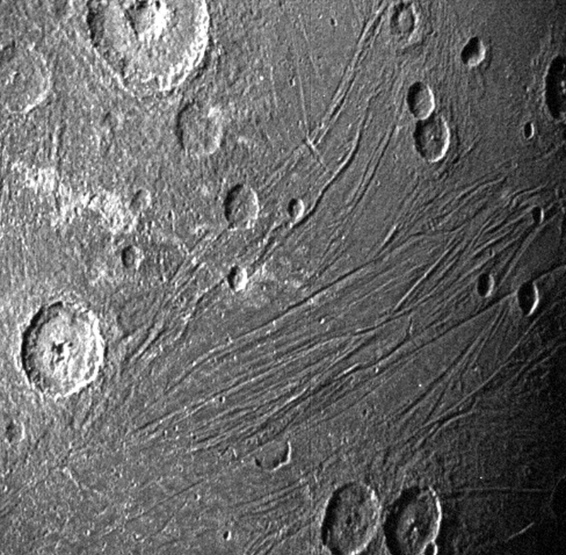
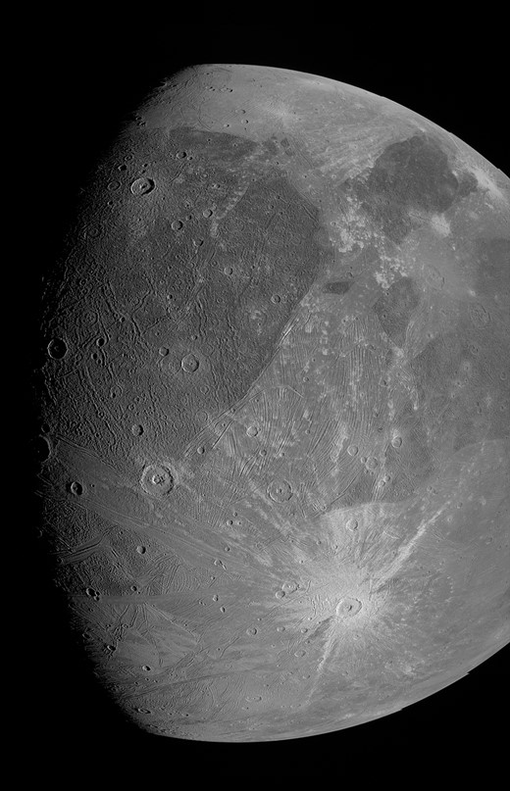
What might we find?
How Ganymede's dynamo is possible? With a small core and no obvious heat source to cause liquification and then convection. Most likely comes from tidal heating. Moon squished by the gravity of Jupiter and the other moons.
Surface separated into two regions meaning weathering on Ganymede's surface by plasma and energetic charged particles is not uniform. Could find that space weathering by electrons causes the brighter poles of Ganymede, as electron fluxes are likely to be more clearly separated between polar and equatorial regions. Aurora might be found.
https://academic-oup-com.ezproxy.lancs.ac.uk/astrogeo/article/63/3/3.12/6586421
https://agupubs-onlinelibrary-wiley-com.ezproxy.lancs.ac.uk/doi/full/10.1029/2022JA030497

Slide 7
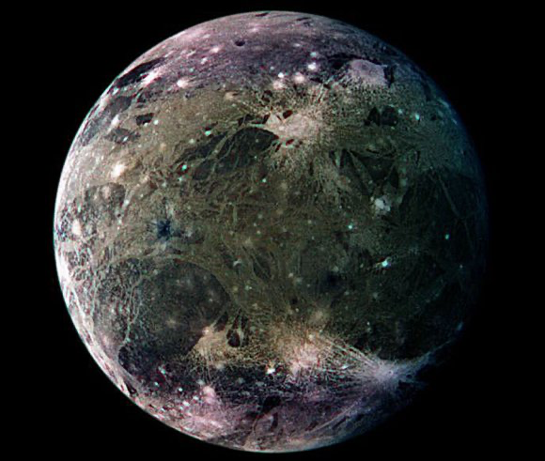
Thank you for listening!
Are there any questions?
Notes:
Introducing who we are and the acronym - Hannah

